Slide 1

Efficient Adaptation of Speech Foundation Model for Low-Resource Task
presented by
Kwok Chin Yuen
Supervisor
Prof. Chng Eng Siong
Revised 28 April 2025

Slide 2
About Me
Name: Kwok Chin Yuen
Status: Fourth Year Ph.D. candidate
Matriculated on 10-Aug-2021
Year 1-3 TAC appraisal passed
QE passed
CGPA: 4.83

Slide 3
Publications
Chin Yuen Kwok, Jia Qi Yip, and Eng Siong Chng. “Extending Whisper for Emotion Prediction Using Word-level Pseudo Labels” 2025 International Conference on Acoustics, Speech, and Signal Processing. IEEE, 2025
Chin Yuen Kwok, Jia Qi Yip, and Eng Siong Chng. “Robust Audio Deepfake Detection using Ensemble Confidence Calibration” 2025 International Conference on Acoustics, Speech, and Signal Processing. IEEE, 2025
Chin Yuen Kwok, Jia Qi Yip and Eng Siong Chng. " Continual Learning Optimizations for Auto-regressive Decoder of Multilingual ASR systems." INTERSPEECH. 2024.
Chin Yuen Kwok, Jia Qi Yip, and Eng Siong Chng. "Low Resource Language Adaptation using Two-stage Regularization for Multilingual ASR." 2025 International Journal on Asian Language Processing (IJALP). IEEE, 2025.
Chin Yuen Kwok, Jia Qi Yip and Eng Siong Chng. " Low Resource Language Adaptation using Two-stage Regularization for Multilingual ASR." The 28th International Conference on Asian Language Processing. 2024 (Best Paper Award)
Chin Yuen Kwok, Jia Qi Yip and Eng Siong Chng. "Improved Alignment for Score Combination of RNN-T and CTC Decoder for Online Decoding." 27th International Conference on Text, Speech and Dialogue. 2024.
Chin Yuen Kwok, Jia Qi Yip and Eng Siong Chng. "CONTINUAL LEARNING WITH EMBEDDING LAYER SURGERY AND TASK-WISE BEAM SEARCH USING WHISPER." 2024 IEEE Spoken Language Technology Workshop. 2024
Chin Yuen Kwok, Jia Qi Yip, and Eng Siong Chng. " Low-resource Language Adaptation with Ensemble of PEFT Approaches." 2024 APSIPA ASC. IEEE, 2024.
Chin Yuen Kwok, Haoyang Li, and Eng Siong Chng. "ASR Model Adaptation for Rare Words Using Synthetic Data Generated by Multiple Text-To-Speech Systems." 2023 APSIPA ASC. IEEE, 2023.

Slide 4
Outline
Introduction
Speech Foundation Model
Low-resource Adaptation
Cross Language Adaptation
Rare Word Adaptation
Contributions
Cross Language Adaptation
Decoder Training Stabilization
Embedding Layer Surgery
Two-stage LoRA
Rare Word Adaptation
TCPGen with Rare-word-aware Loss
Trie-based Postprocessing with K-step Prediction
Conclusions & Future Work

Slide 5
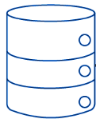



A1. Speech Foundation Model
What is speech foundation model (SFM)?
Pre-trained on large-scale speech data
General purpose
Large neural network
Supported task:
ASR only
Supported tasks:
ASR,IC,ER,SV,ST,VC
TEXT
Dec Layer 32
TEXT
…
TEXT
Dec Layer 32
Dec Layer 3
Dec Layer 4
…
Enc
Dec Layer 2
Dec Layer 3
Dec Layer 3
Dec Layer 1
Enc
Dec Layer 2
Enc
Dec Layer 2
TEXT
100 hour
training data
Dec Layer 1
Dec Layer 1
1M hour
training data
TEXT
TEXT
Speech Model
Speech Foundation Model

Slide 6
Specialized Model
Task: ASR only
(B)
Generic Model
Tasks: ASR,IC,ER,SV,…
Small
(4 layer)
model
Large
(32 layer)
model
TEXT
(C)
TEXT
Layer 4
Layer 32
…
TEXT
Layer 3
decoder
layers
Layer 3
decoder
layers
Dec Layer 32
Layer 2
Encoder
Layer 2
…
Encoder
Small (100h)
training dataset
Layer 1
Layer 1
Large (1M hour)
training dataset
Dec Layer 3
TEXT
TEXT
Enc
Dec Layer 2
(A)
Dec Layer 1
Speech Model
Speech Foundation Model
TEXT

Slide 7
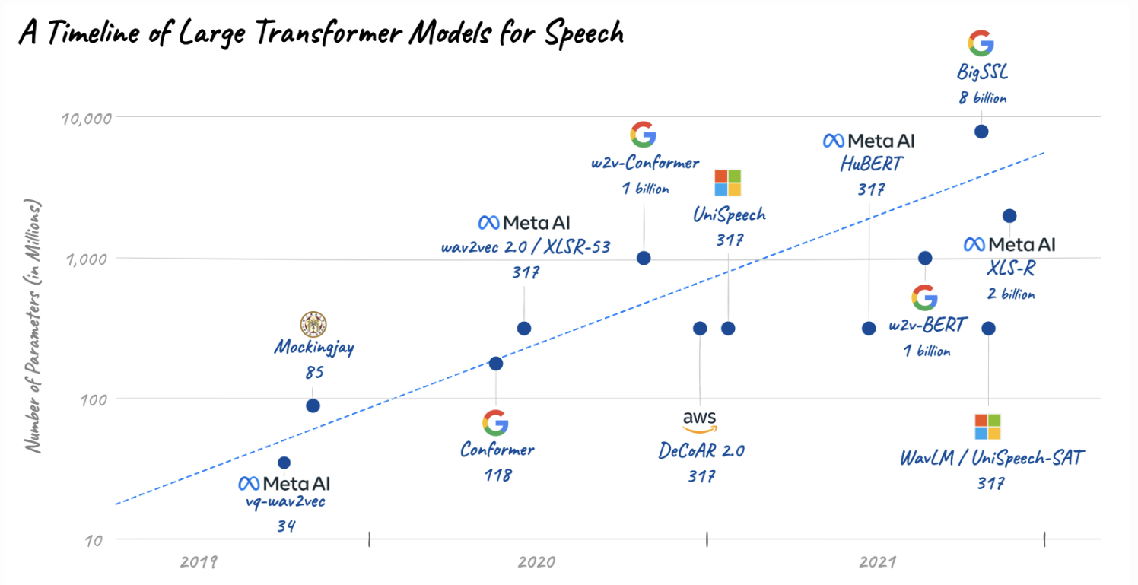

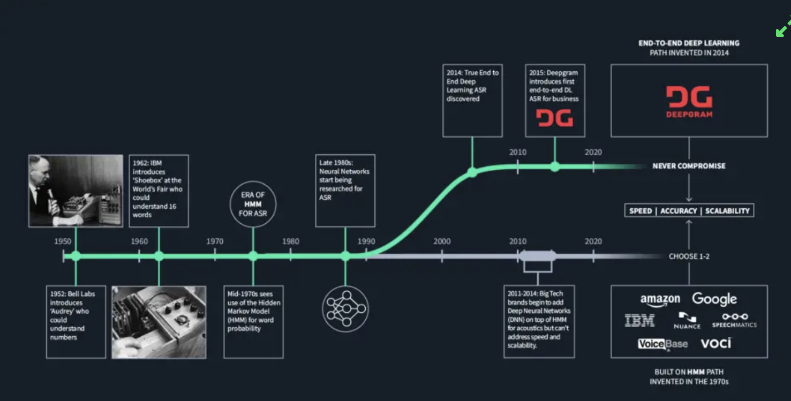
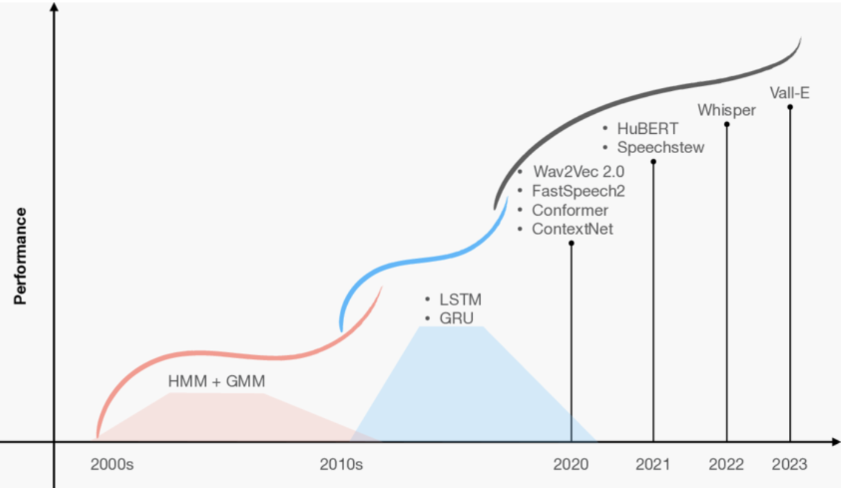
A1. Speech Foundation Model
Advances of speech models
Earlier models only focus on single task (e.g. ASR)
HMM models DNN-HMM models DNN models
Larger data size larger model size LLM-based [17]
BigSSL [11]
8B
x
x
Qwen Audio 2 [16]
MMS [15]
x
x
Whisper [14]
1B
x
x
XLS-R [13]
x
w2v-conformer [8]
SpeechStew [10]
https://medium.com/descript/a-brief-history-of-asr-automatic-speech-recognition-b8f338d4c0e5
#
param
x
300M
GNN-HMM [1]
x
DNN-HMM [2]
WavLM [12]
Model | Year | Model size (param) | Training data size (hours)
GNN-HMM [1] | 2000s | ~200M | 1K
Kaldi DNN-HMM [2] | 2000s | ~200M | 1K
LSTM [3] | 2010s | 130M | 2K
Vq wav2vec [4] | 2019 | 34M | 1K
Mocking jay [5] | 2019 | 85M | 360h
Conformer [6] | 2020 | 118M | 1K
Wav2vec 2 [7] | 2020 | 317M | 60K
W2v-Conformer [8] | 2020 | 1B | 60K
Hubert [9] | 2021 | 317M | 60K
Speechstew [10] | 2021 | 1B | 610k
BigSSL [11] | 2021 | 8B | 34K
wavLM [12] | 2021 | 317M | 94K
XLS-R [13] | 2021 | 2B | 436K
OpenAI Whisper [14] | 2022 | 1.5 B | 680 K
MetaAI MMS [15] | 2023 | 1B | 44.7K
Qwen Audio 2 [16] | 2024 | 7B | 520 K
x
Wav2vec2 [7]
Hubert [9]
100M
x
x
LSTM [3]
Conformer [6]
x
Mockingjay [5]
50M
timeline
x
vq-wav2vec [4]
1K
50K
100K
500K
1M
Data size (hours)
https://jonathanbgn.com/2021/12/31/timeline-transformers-speech.html
[1] Vertanen, Keith. “Baseline Wsj Acoustic Models for Htk and Sphinx : Training Recipes and Recognition Experiments.” (2007).
[2] Wang, Song and Guanyu Li. “Overview of end-to-end speech recognition.” Journal of Physics: Conference Series 1187 (2019): n. pag.
[3] Chan, William et al. “Listen, attend and spell: A neural network for large vocabulary conversational speech recognition.” 2016 IEEE International Conference on Acoustics, Speech and Signal Processing (ICASSP) (2015): 4960-4964.
[4] Baevski, Alexei et al. “vq-wav2vec: Self-Supervised Learning of Discrete Speech Representations.” ArXiv abs/1910.05453 (2019): n. pag.
[5] Liu, Andy T. et al. “Mockingjay: Unsupervised Speech Representation Learning with Deep Bidirectional Transformer Encoders.” ICASSP 2020 - 2020 IEEE International Conference on Acoustics, Speech and Signal Processing (ICASSP) (2019): 6419-6423.
[6] Gulati, Anmol et al. “Conformer: Convolution-augmented Transformer for Speech Recognition.” ArXiv abs/2005.08100 (2020): n. pag
[7] . Baevski, Alexei et al. “wav2vec 2.0: A Framework for Self-Supervised Learning of Speech Representations.” ArXiv abs/2006.11477 (2020): n. pag.
[8] Zhang, Yu et al. “Pushing the Limits of Semi-Supervised Learning for Automatic Speech Recognition.” ArXiv abs/2010.10504 (2020): n. pag.
[9] Hsu, Wei-Ning et al. “HuBERT: Self-Supervised Speech Representation Learning by Masked Prediction of Hidden Units.” IEEE/ACM Transactions on Audio, Speech, and Language Processing 29 (2021): 3451-3460.
[10] Chan, William et al. “SpeechStew: Simply Mix All Available Speech Recognition Data to Train One Large Neural Network.” ArXiv abs/2104.02133 (2021): n. pag.
[11] Zhang, Yu et al. “BigSSL: Exploring the Frontier of Large-Scale Semi-Supervised Learning for Automatic Speech Recognition.” IEEE Journal of Selected Topics in Signal Processing 16 (2021): 1519-1532.
[12] Chen, Sanyuan et al. “WavLM: Large-Scale Self-Supervised Pre-Training for Full Stack Speech Processing.” IEEE Journal of Selected Topics in Signal Processing 16 (2021): 1505-1518.
[13] Babu, Arun et al. “XLS-R: Self-supervised Cross-lingual Speech Representation Learning at Scale.” ArXiv abs/2111.09296 (2021): n. pag.
[14] Radford, Alec, et al. "Robust speech recognition via large-scale weak supervision." International Conference on Machine Learning. PMLR, 2023.
[15 Pratap, Vineel, et al. "Scaling speech technology to 1,000+ languages." arXiv preprint arXiv:2305.13516 (2023).
[16] Chu, Yunfei et al. “Qwen2-Audio Technical Report.” ArXiv abs/2407.10759 (2024): n. pag.
[17] https://arxiv.org/pdf/2410.18908
https://www.researchgate.net/publication/370443267_A_Review_of_Deep_Learning_Techniques_for_Speech_Processing

Slide 8
Foundation ASR
End-to-end ASR
ASR Performance
Hybrid
ASR
Wav2vec2, Whisper,
Qwen2-audio
Statistical
ASR
CTC, RNN-T,
Transformer
-
More training
data (e.g. 1M hours)
Larger model
size (e.g. 7b)
DNN-HMM
-
End-to-end training pipeline
using only
neural network
HMM-GMM
-
Replace GMM
w/ deep neural
network
-
-
Separate pipeline
for acoustic &
language modelling
Large data and model era
Deep learning era
statistical era
year
1980s - 2000s
2006 - 2020
2020 - now

Slide 9
(A)
Conventional pipeline
(B)
Continuous Emb.
(C)
Discrete Token
T
I like tennis
T
I like tennis
T
I like tennis
LLM
LLM
LLM
T
I like ten niece
Discrete
Token
Continuous
Embedding
or
or
101
23
906
582
Speech
Decoder
K-means
Speech
Encoder
Speech
Encoder
Speech
Encoder
I like tennis
I like tennis
I like tennis

Slide 10
(A)
Conventional pipeline
(B)
Continuous Emb.
(C)
Discrete Token
T
I like tennis
LLM
T
I like ten niece
Discrete
Token
Continuous
Embedding
or
or
101
23
906
582
Speech
Decoder
K-means
Speech
Encoder
I like tennis

Slide 11
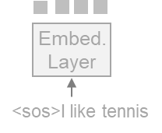
T
I like tennis
(D)
I like ten niece <eos>
cross
attention
Speech
Decoder
LLM
Speech
Encoder
Emb.
Layer
T
I like ten niece
(C)
Discrete
Token Emb.
(Text embedding inputs
are ignored for simplicity)
(B)
Continuous
Embedding
or
or
101
23
906
582
<sos>I like tennis
(A)
Speech
Decoder
(E)
I like tennis <eos>
Embed.
Layer
K-means
LLM
<sos>I like tennis
Speech
Encoder
(Text embedding inputs
are ignored for simplicity)
or
Emb.
Layer
Speech
Encoder
I like tennis
<sos>I like tennis

Slide 12
BigSSL [11]
8B
x
x
Qwen Audio 2 [16]
MMS [15]
x
x
Whisper [14]
1B
x
x
XLS-R [13]
x
w2v-conformer [8]
SpeechStew [10]
Model Size
(# Param)
x
x
300M
GNN-HMM [1]
DNN-HMM [2]
WavLM [12]
x
Wav2vec2 [7]
Hubert [9]
100M
x
x
LSTM [3]
Conformer [6]
2000
2020
2025
x
Mockingjay [5]
https://medium.com/descript/a-brief-history-of-asr-automatic-speech-recognition-b8f338d4c0e5
50M
x
timeline
Model | Year | Model size (param) | Training data size (hours)
GNN-HMM [1] | 2000s | ~200M | 1K
Kaldi DNN-HMM [2] | 2000s | ~200M | 1K
LSTM [3] | 2010s | 130M | 2K
Vq wav2vec [4] | 2019 | 34M | 1K
Mocking jay [5] | 2019 | 85M | 360h
Conformer [6] | 2020 | 118M | 1K
Wav2vec 2 [7] | 2020 | 317M | 60K
W2v-Conformer [8] | 2020 | 1B | 60K
Hubert [9] | 2021 | 317M | 60K
Speechstew [10] | 2021 | 1B | 610k
BigSSL [11] | 2021 | 8B | 34K
wavLM [12] | 2021 | 317M | 94K
XLS-R [13] | 2021 | 2B | 436K
OpenAI Whisper [14] | 2022 | 1.5 B | 680 K
MetaAI MMS [15] | 2023 | 1B | 44.7K
Qwen Audio 2 [16] | 2024 | 7B | 520 K
vq-wav2vec [4]
1K
50K
100K
500K
1M
Data Size (hours)
https://jonathanbgn.com/2021/12/31/timeline-transformers-speech.html
[1] Vertanen, Keith. “Baseline Wsj Acoustic Models for Htk and Sphinx : Training Recipes and Recognition Experiments.” (2007).
[2] Wang, Song and Guanyu Li. “Overview of end-to-end speech recognition.” Journal of Physics: Conference Series 1187 (2019): n. pag.
[3] Chan, William et al. “Listen, attend and spell: A neural network for large vocabulary conversational speech recognition.” 2016 IEEE International Conference on Acoustics, Speech and Signal Processing (ICASSP) (2015): 4960-4964.
[4] Baevski, Alexei et al. “vq-wav2vec: Self-Supervised Learning of Discrete Speech Representations.” ArXiv abs/1910.05453 (2019): n. pag.
[5] Liu, Andy T. et al. “Mockingjay: Unsupervised Speech Representation Learning with Deep Bidirectional Transformer Encoders.” ICASSP 2020 - 2020 IEEE International Conference on Acoustics, Speech and Signal Processing (ICASSP) (2019): 6419-6423.
[6] Gulati, Anmol et al. “Conformer: Convolution-augmented Transformer for Speech Recognition.” ArXiv abs/2005.08100 (2020): n. pag
[7] . Baevski, Alexei et al. “wav2vec 2.0: A Framework for Self-Supervised Learning of Speech Representations.” ArXiv abs/2006.11477 (2020): n. pag.
[8] Zhang, Yu et al. “Pushing the Limits of Semi-Supervised Learning for Automatic Speech Recognition.” ArXiv abs/2010.10504 (2020): n. pag.
[9] Hsu, Wei-Ning et al. “HuBERT: Self-Supervised Speech Representation Learning by Masked Prediction of Hidden Units.” IEEE/ACM Transactions on Audio, Speech, and Language Processing 29 (2021): 3451-3460.
[10] Chan, William et al. “SpeechStew: Simply Mix All Available Speech Recognition Data to Train One Large Neural Network.” ArXiv abs/2104.02133 (2021): n. pag.
[11] Zhang, Yu et al. “BigSSL: Exploring the Frontier of Large-Scale Semi-Supervised Learning for Automatic Speech Recognition.” IEEE Journal of Selected Topics in Signal Processing 16 (2021): 1519-1532.
[12] Chen, Sanyuan et al. “WavLM: Large-Scale Self-Supervised Pre-Training for Full Stack Speech Processing.” IEEE Journal of Selected Topics in Signal Processing 16 (2021): 1505-1518.
[13] Babu, Arun et al. “XLS-R: Self-supervised Cross-lingual Speech Representation Learning at Scale.” ArXiv abs/2111.09296 (2021): n. pag.
[14] Radford, Alec, et al. "Robust speech recognition via large-scale weak supervision." International Conference on Machine Learning. PMLR, 2023.
[15 Pratap, Vineel, et al. "Scaling speech technology to 1,000+ languages." arXiv preprint arXiv:2305.13516 (2023).
[16] Chu, Yunfei et al. “Qwen2-Audio Technical Report.” ArXiv abs/2407.10759 (2024): n. pag.
[17] https://arxiv.org/pdf/2410.18908
https://www.researchgate.net/publication/370443267_A_Review_of_Deep_Learning_Techniques_for_Speech_Processing

Slide 13
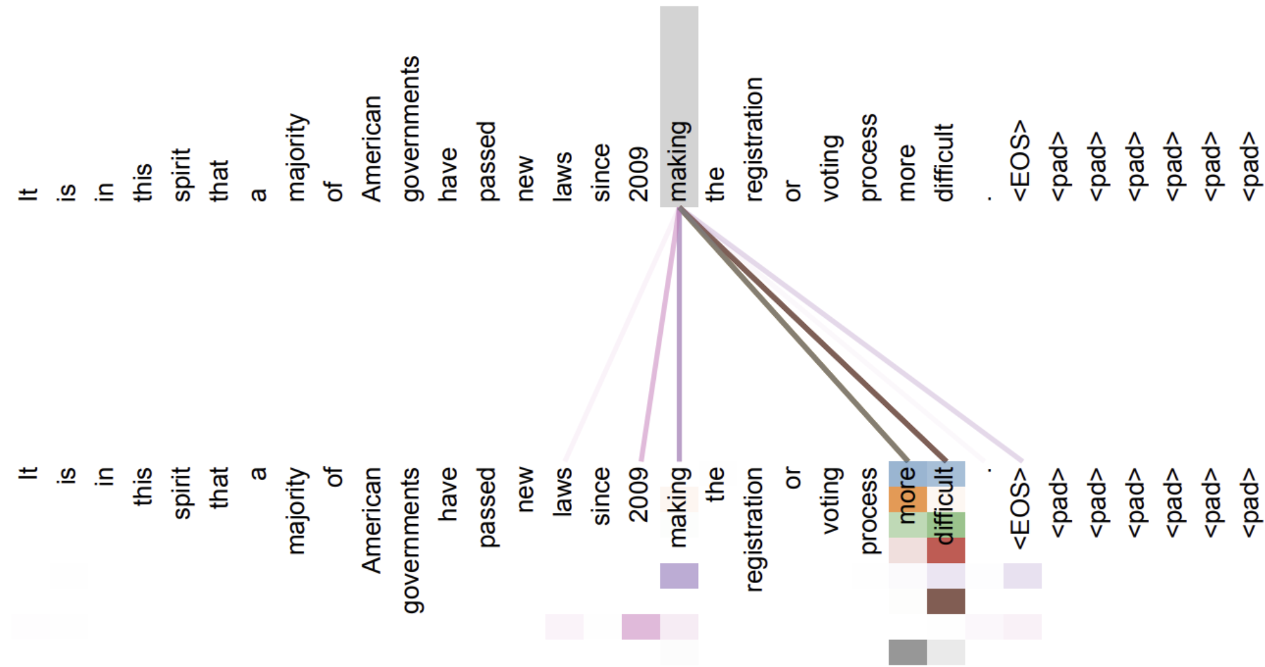

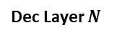
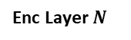
TEXT
(B)
Linear and Softmax
Add & Norm
Decoder
(A)
Dec Layer $N$
FFN
…
layer
Encoder
Add & Norm
Enc Layer $N$
Add & Norm
(F)
layer
Dec Layer 3
FFN
…
MHA
https://medium.com/descript/a-brief-history-of-asr-automatic-speech-recognition-b8f338d4c0e5
Dec Layer 2
Enc
output
Add & Norm
Enc Layer 1
Dec Layer 1
Add & Norm
Model | Year | Model size (param) | Training data size (hours)
GNN-HMM [1] | 2000s | ~200M | 1K
Kaldi DNN-HMM [2] | 2000s | ~200M | 1K
LSTM [3] | 2010s | 130M | 2K
Vq wav2vec [4] | 2019 | 34M | 1K
Mocking jay [5] | 2019 | 85M | 360h
Conformer [6] | 2020 | 118M | 1K
Wav2vec 2 [7] | 2020 | 317M | 60K
W2v-Conformer [8] | 2020 | 1B | 60K
Hubert [9] | 2021 | 317M | 60K
Speechstew [10] | 2021 | 1B | 610k
BigSSL [11] | 2021 | 8B | 34K
wavLM [12] | 2021 | 317M | 94K
XLS-R [13] | 2021 | 2B | 436K
OpenAI Whisper [14] | 2022 | 1.5 B | 680 K
MetaAI MMS [15] | 2023 | 1B | 44.7K
Qwen Audio 2 [16] | 2024 | 7B | 520 K
(E)
MHA
MHA
Feature Extraction
Embedding Layer
Transformer
block
I like xiao mi
Transformer
block
(C)
TEXT
(D)
https://jonathanbgn.com/2021/12/31/timeline-transformers-speech.html
https://www.researchgate.net/publication/370443267_A_Review_of_Deep_Learning_Techniques_for_Speech_Processing

Slide 14
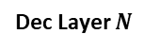
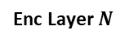
tennis
網球
Linear and Softmax
Linear and Softmax
Dec Layer $N$
Dec Layer $N$
…
layer
…
layer
Enc Layer $N$
Dec Layer 3
Enc Layer $N$
Dec Layer 3
…
layer
…
layer
Dec Layer 2
Dec Layer 2
Enc Layer 1
Dec Layer 1
Enc Layer 1
Dec Layer 1
Feature Extraction
Embedding Layer
Feature Extraction
Embedding Layer
I like tennis
(A)
I like tennis
(B)
<transcribe> I like
<translate> 我喜歡

Slide 15

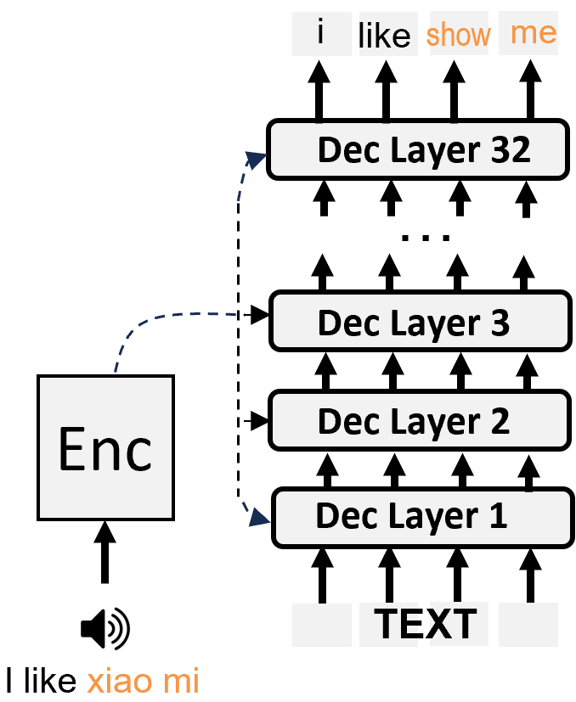
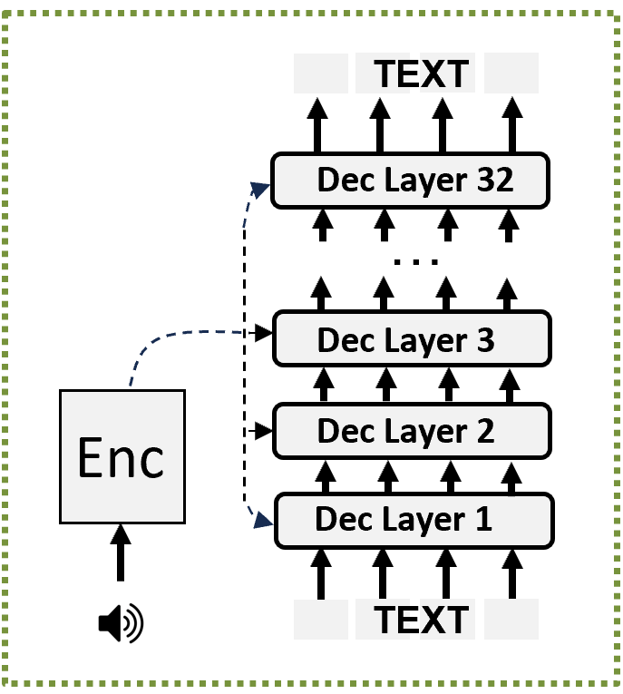
A1. Speech Foundation Model
What is the limitation of SFMs?
Limited number of supported languages
Rare word recognition
~7000 languages
i
like
show
me
but
Dec Layer 32
…
Supports
~75 languages only
Dec Layer 3
Enc
Dec Layer 2
Dec Layer 1
TEXT
I like xiao mi

Slide 16
A2. Low-resource Adaptation
Why do we need low-resource adaptation?
Limited number of supported languages
Rare word recognition
~7000 languages
i
like
show
me
but
Dec Layer 32
…
Supports
~75 languages only
Dec Layer 3
Enc
Dec Layer 2
Dec Layer 1
TEXT
I like xiao mi

Slide 17

A2. Low-resource Adaptation
Why do we need low-resource adaptation?
Limited number of supported languages -> adapt with new language data
Rare word recognition -> adapt with rare word dataset
~7000 languages
Section B
i
like
show
me
but
Dec Layer 32
1M hour
old language
data
…
Supports
~75 languages only
10 hour
rare word
data
Dec Layer 3
Enc
Dec Layer 2
Dec Layer 1
+
Section C
TEXT
10 hour
new language
data
I like xiao mi

Slide 18
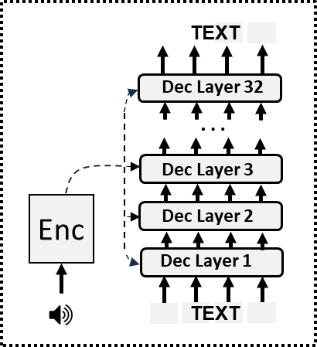
~7000 languages
but
Speech foundation model supports
<100 languages for ASR
i
like
show
me
10h
rare word
Dec Layer 32
…
+
Dec Layer 3
Enc
Dec Layer 2
1M hour old
language
10h new
language
Dec Layer 1
TEXT
I like xiao mi

Slide 19
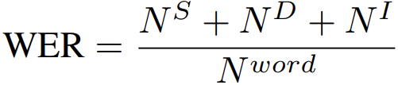
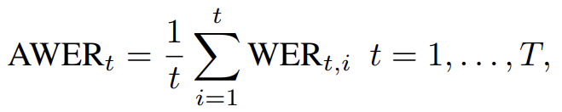
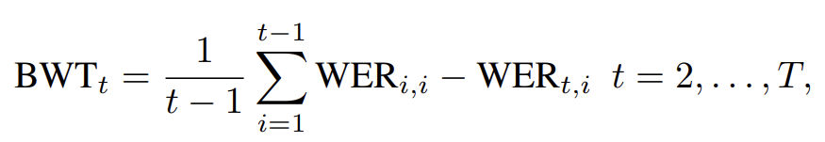
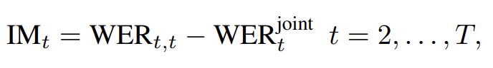

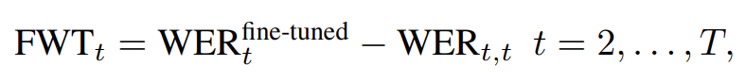
A2. Low-resource Adaptation
[1] Della Libera, Luca, et al. "CL-MASR: A Continual Learning Benchmark for Multilingual ASR." arXiv preprint arXiv:2310.16931 (2023)
Evaluation Metrics [1]
Higher the better
Lower the better
Word Error Rate (WER) Performance on one task
# substitution, deletion and insertion errors
total # of words in ground-truth transcript
Average Word Error Rate (AWER) avg. performance on multiple tasks
task i WER after training sequentially to task t
Backward Transfer How much Forgetting
task i WER after training sequentially to task t > i
task i WER after training sequentially to task i
Intransigence Measure Ability to learn new task knowledge
task t WER if training on all tasks jointly instead of sequentially
Forward Transfer Does previous task help improve next task?
task t WER after training sequentially to task t
task t WER if training on a single task t only

Slide 20
A2. Low-resource Adaptation
How to perform low-resource adaptation?
1. Take a pretrained speech model
How to perform ASR adaptation?
2. Adapt it to new tasks using new tasks data
Pre-training Step
Adaptation Step
Pre-train model
with Task A knowledge
Adapt model
with task B knowledge
Pretrain on
Task A
Adapt on
Task B
Untrained Model
Task A Model
Model adapted to Task B
Dataset for
Task A
Dataset for
Task B

Slide 21
A2. Low-resource Adaptation
How to perform low-resource adaptation?
1. Take a pretrained speech model
How to perform ASR adaptation?
2. Adapt it to new tasks using new tasks data
Pre-training Step
Adaptation Step
Pre-train model
with Task A knowledge
Adapt model
with task B knowledge
Pretrain on
Task A
Adapt on
Task B
Untrained Model
Task A Model
Model adapted to Task B
Dataset for
Task A
Dataset for
Task B

Slide 22
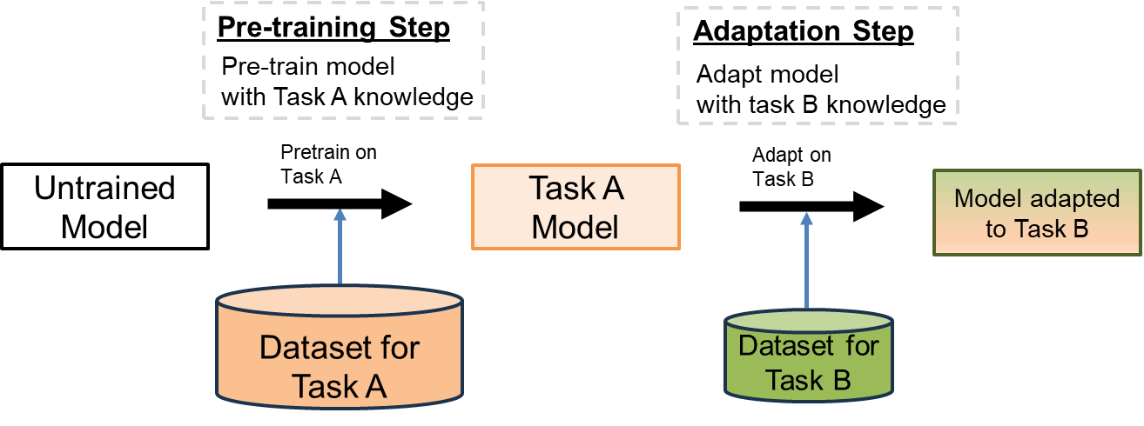
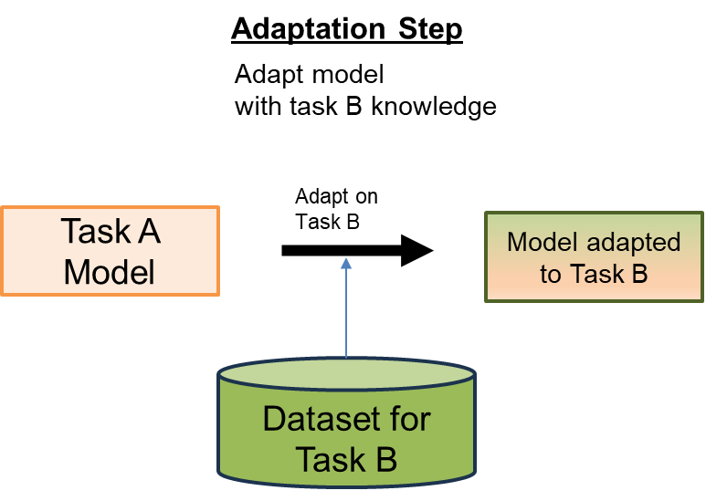
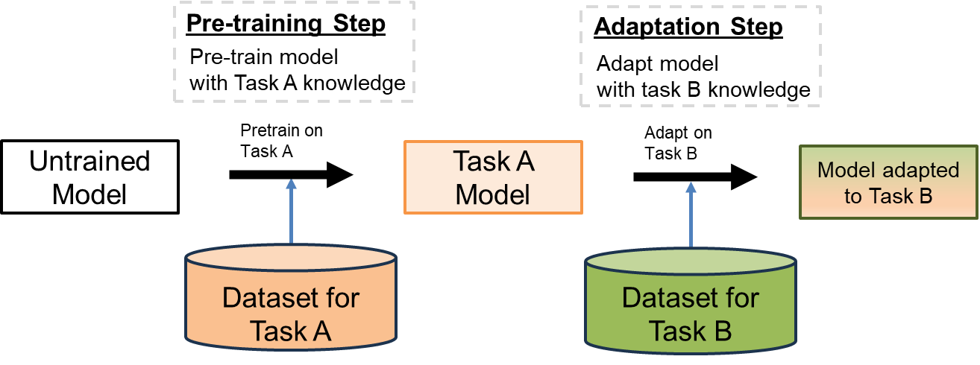

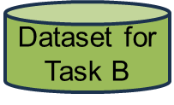
A2. Low-resource Adaptation
How to perform low-resource adaptation?
1. Take a pretrained speech model
How to perform ASR adaptation?
2. Adapt it to new tasks using new tasks data
Improvements focusing on 3 areas
(B)
(C)
(Limited size)
(A)
(Limited size)

Slide 23
A2. Low-resource Adaptation
What adaptation techniques are there?
Data
Processing
Adaptation Step
Adapt model
with task B knowledge
Low-resource
Adaptation
Dynamic
Architecture
Adapt on
Task B
Task A Model
Model adapted to Task B
Regularization
Dataset for
Task B
…
Notes:
Reduce overfitting and catastrophic forgetting. E.g. Including L2 penalty into training loss
Provide additional information besides audio. E.g. provide speaker information besides audio
Adapt ASR model under various resource constraints. E.g. adapt partial model weights to reduce training computation cost
E.g. Maximum Likelihood Linear Regression

Slide 24
A2. Low-resource Adaptation
What adaptation techniques are there?
Data
Processing
Adaptation Step
Adapt model
with task B knowledge
Low-resource
Adaptation
Dynamic
Architecture
Adapt on
Task B
Task A Model
Model adapted to Task B
Regularization
Dataset for
Task B
…
Notes:
Reduce overfitting and catastrophic forgetting. E.g. Including L2 penalty into training loss
Provide additional information besides audio. E.g. provide speaker information besides audio
Adapt ASR model under various resource constraints. E.g. adapt partial model weights to reduce training computation cost
E.g. Maximum Likelihood Linear Regression

Slide 25
A2. Low-resource Adaptation
What adaptation techniques are there?
Data
Processing
Adaptation Step
Adapt model
with task B knowledge
Low-resource
Adaptation
Dynamic
Architecture
Adapt on
Task B
Task A Model
Model adapted to Task B
Regularization
Dataset for
Task B
…
Notes:
Reduce overfitting and catastrophic forgetting. E.g. Including L2 penalty into training loss
Provide additional information besides audio. E.g. provide speaker information besides audio
Adapt ASR model under various resource constraints. E.g. adapt partial model weights to reduce training computation cost
E.g. Maximum Likelihood Linear Regression

Slide 26
A2. Low-resource Adaptation
What adaptation techniques are there?
Data
Processing
Adaptation Step
Adapt model
with task B knowledge
Low-resource
Adaptation
Dynamic
Architecture
Adapt on
Task B
Task A Model
Model adapted to Task B
Regularization
Dataset for
Task B
…
Notes:
Reduce overfitting and catastrophic forgetting. E.g. Including L2 penalty into training loss
Provide additional information besides audio. E.g. provide speaker information besides audio
Adapt ASR model under various resource constraints. E.g. adapt partial model weights to reduce training computation cost
E.g. Maximum Likelihood Linear Regression

Slide 27
A2. Low-resource Adaptation
What adaptation techniques are there?
Data
Processing
Adaptation Step
Adapt model
with task B knowledge
Low-resource
Adaptation
Dynamic
Architecture
Adapt on
Task B
Task A Model
Model adapted to Task B
Regularization
Dataset for
Task B
…
Notes:
Reduce overfitting and catastrophic forgetting. E.g. Including L2 penalty into training loss
Provide additional information besides audio. E.g. provide speaker information besides audio
Adapt ASR model under various resource constraints. E.g. adapt partial model weights to reduce training computation cost
E.g. Maximum Likelihood Linear Regression

Slide 28
A2. ASR Adaptation
What ASR adaptation techniques are there?
Data Selection [1]
Data
Processing
Data Generation [2]
Data Augmentation [3]
Data Normalization [4]
Auxiliary Encoded Features [5]
Adapter [6]
Dynamic
Architecture
Embedding Store [7]
ASR
Adaptation
Feature Extraction [8]
LORA + … [9]
Scaling and Bias [10]
Feature Transformation [11]
Match Output Distribution [12]
Regularization
Increase Confidence [13]
Match Model Parameter [14]
Auxiliary Task Loss [15]
[1] Kothawade, Suraj, et al. "DITTO: Data-efficient and Fair Targeted Subset Selection for ASR Accent Adaptation." Proceedings of the 61st Annual Meeting of the Association for Computational Linguistics (Volume 1: Long Papers). 2023.
[2] Li, Jinyu, et al. "Developing RNN-T models surpassing high-performance hybrid models with customization capability." arXiv preprint arXiv:2007.15188 (2020).
[3] Yuen, Kwok Chin, Li Haoyang, and Chng Eng Siong. "ASR Model Adaptation for Rare Words Using Synthetic Data Generated by Multiple Text-To-Speech Systems." 2023 Asia Pacific Signal and Information Processing Association Annual Summit and Conference (APSIPA ASC). IEEE, 2023.
[4] Lee, Li, and Richard C. Rose. "Speaker normalization using efficient frequency warping procedures." 1996 IEEE International Conference on Acoustics, Speech, and Signal Processing Conference Proceedings. Vol. 1. IEEE, 1996.
[5] Saon, George, et al. "Speaker adaptation of neural network acoustic models using i-vectors." 2013 IEEE Workshop on Automatic Speech Recognition and Understanding. IEEE, 2013.
[6] Han, Sungjun, Deepak Baby, and Valentin Mendelev. "Residual adapters for targeted updates in RNN-transducer based speech recognition system." 2022 IEEE Spoken Language Technology Workshop (SLT). IEEE, 2023.
[7] Dingliwa, Saket, et al. "Domain prompts: Towards memory and compute efficient domain adaptation of ASR systems." (2022).
[8] Sukhadia, Vrunda N., and S. Umesh. "Domain adaptation of low-resource target-domain models using well-trained asr conformer models." 2022 IEEE Spoken Language Technology Workshop (SLT). IEEE, 2023.
[9] Sim, Khe Chai, et al. "Domain Adaptation Using Factorized Hidden Layer for Robust Automatic Speech Recognition." Interspeech. 2018.
[10] Swietojanski, Pawel, Jinyu Li, and Steve Renals. "Learning hidden unit contributions for unsupervised acoustic model adaptation." IEEE/ACM Transactions on Audio, Speech, and Language Processing 24.8 (2016): 1450-1463.
[11] Gales, Mark JF. "Maximum likelihood linear transformations for HMM-based speech recognition." Computer speech & language 12.2 (1998): 75-98.
[12] Li, Qingxuan, et al. "Sequence Distribution Matching for Unsupervised Domain Adaptation in ASR." 2022 13th International Symposium on Chinese Spoken Language Processing (ISCSLP). IEEE, 2022.
[13] Lin, Guan-Ting, Shang-Wen Li, and Hung-yi Lee. "Listen, adapt, better wer: Source-free single-utterance test-time adaptation for automatic speech recognition." arXiv preprint arXiv:2203.14222 (2022).
[14] Liao, Hank. "Speaker adaptation of context dependent deep neural networks." 2013 IEEE International Conference on Acoustics, Speech and Signal Processing. IEEE, 2013
[15] Klejch, Ondrej, et al. "Lattice-based unsupervised test-time adaptation of neural network acoustic models." arXiv preprint arXiv:1906.11521 (2019)..
Notes:
Reduce overfitting and catastrophic forgetting. E.g. Including L2 penalty into training loss
Provide additional information besides audio. E.g. provide speaker information besides audio
Adapt ASR model under various resource constraints. E.g. adapt partial model weights to reduce training computation cost
E.g. Maximum Likelihood Linear Regression

Slide 29
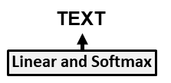






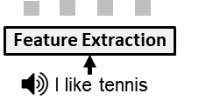
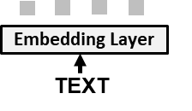

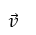
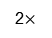
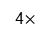
Linear layer
(B)
Sequential
Adapter (SA)
(D)
PiggyBack
Train
module
Learnt binary mask
on the entire decoder
Original
decoder
weights
Freeze
module
Decoder
Add & Norm
SA
inserted
$$W_{up}$$
$$\vec{u}$$
$$\vec{v}$$
Learnable gates
Add & Norm
ReLU
$$∗$$
Element-wise
multiplication
2$×$
MHA
$$W_{down}$$
Up/down
Projection layer
FFN
Adapter
$$W_{down}$$
$$W_{up}$$
Add & Norm
(C)
Parallel
Adapter (PA)
Element-wise
masking
Enc
MHA
4$×$
N$×$
Add & Norm
Add & Norm
MHA
MHA
4$×$
PA
added
New decoder
weights
(E)
(F)
LoRA
$$W_{up}$$
LoRA
variants
$$\vec{u}$$
$$∗$$
$$W_{up}$$
(A)
$$W_{down}$$
$$\vec{v}$$
$$∗$$
$$W_{down}$$
added
added

Slide 30
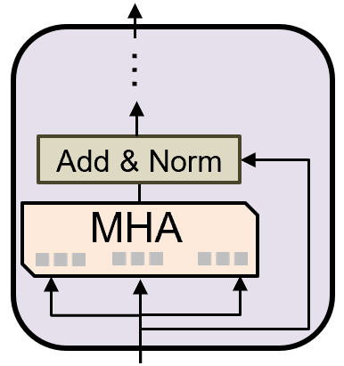
(A)
(B)
(C)
Vanilla fine-tuning
Prompt tuning
Prefix tuning
Transformer
decoder block
Layer
output
Layer
output
Layer
output
Feature vector
…
…
…
Trainable prompt
Add & Norm
Add & Norm
Add & Norm
Features derived
from prompt
Q
MHA
V
MHA
MHA
K
Q
K
V
Q
K
V
Trainable prefix
Train weight
Freeze weight

Slide 31










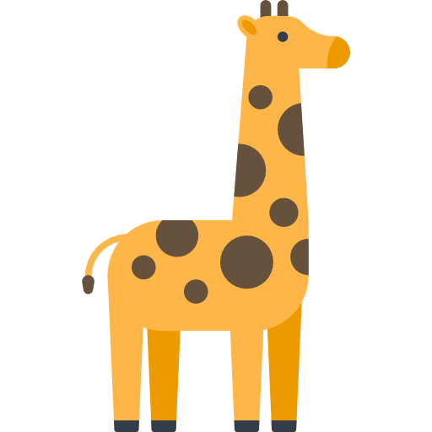



Scenarios
Data stream at the beginning of training
Data stream after training for some time
Testing stage
Is this a dog/cat?
Is this a dog/cat?
Is this a dog/cat?
(A)
…
Distribution
Unchanged
…
IIL:
Is this a dog/cat?
Is this a dog/cat?
Is this a dog/cat?
(B)
…
Distribution
Changed
…
DIL:
Is this a dog/cat?
flat icon - animal-shelter_7577239
flat icon - pets_15721652
flat icon - animal_10890561
flat icon - pet_2924299
…
Is this a giraffe/elephant?
Is this a giraffe/elephant?
(C)
TIL:
Distribution
Changed
…
…
Is this a dog/cat?
Is this a giraffe/elephant?
Is this a dog/cat/giraffe/elephant?
(D)
CIL:
Distribution
Changed
…
Is this a dog/cat/giraffe/elephant?
flat icon - giraffe_166727
flat icon - elephant_7743300
…
Is this a dog/cat/giraffe/elephant?
Is this a dog/cat/giraffe/elephant?
Attribution:
(E)
TFCL:
Distribution
Changed
…
flat icon - cat_8277431
flat icon - dog_1998627
flat icon - dog_4540789
flat icon robot_3398643
flat icon - elephant_3065702
flat icon - pet_2924299
flat icon - elephant_3065702
flat icon - elephant_7743300
flat icon - giraffe_166727
flat icon - giraffe_1018365
Is this a dog/cat/giraffe/elephant?
Is this a dog/cat/giraffe/elephant?
Is this a dog/cat/giraffe/elephant?
flat icon - robot_3398643
flat icon - cat_8277431
flat icon - cat_8277431
flat icon - dog_1998627
flat icon - dog_4540789
flat icon - animal-shelter_7577239
flat icon - animal_10890561
flat icon - pets_15721652
(F)
OCL:
…
Distribution
Changed
…
Does not retrain on old image
Is this a dog/cat/giraffe/elephant?
Is this a dog/cat/giraffe/elephant?
Is this a dog/cat/giraffe/elephant?
(G)
BBCL:
…
Distribution
Changed
…
Is this a dog/cat?
flat icon - cat_8277431
flat icon - giraffe_1018365
Is this a giraffe/elephant?
Not applicable.
The model is still in the
pre-training stage
(H)
CPT:
…
Distribution
Changed
…
Attribution:
flat icon - robot_3398643
flat icon - robot_3398643
flat icon - dog_1998627
flat icon - animal_10890561
flat icon - elephant_3065702
flat icon - giraffe_1018365
flat icon - cat_8277431
flat icon - dog_4540789
flat icon - pets_15721652
flat icon - elephant_7743300
flat icon - cat_8277431
flat icon - animal-shelter_7577239
flat icon - pet_2924299
flat icon - giraffe_166727

Slide 32
Outline
Introduction
Speech Foundation Model
Low-resource Adaptation
Cross Language Adaptation
Rare Word Adaptation
Contributions
Cross Language Adaptation
Decoder Training Stabilization
Embedding Layer Surgery
Two-stage LoRA
Rare Word Adaptation
TCPGen with Rare-word-aware Loss
Trie-based Postprocessing with K-step Prediction
Conclusions & Future Work

Slide 33

B1. Cross Language Adaptation
What is cross language adaptation?
Extend speech model to support new languages
75 languages
76 languages
77 languages
78 languages
Salve
Hej
Salve
Hej
Salve
Geia
WER (%)
Train model
w/ Latin data
Train model
w/ Danish data
Train model
w/ Greek data
100
75
50
25
…
0
75
languages
Latin
Danish
Greek

Slide 34
B1. Cross Language Adaptation
What is the challenge of cross language adaptation?
Forgets languages pretrained
Forgets new languages previously learned
Model size increases severity of forgetting increases [1]
WER (%)
Train model
w/ Latin data
Train model
w/ Danish data
Train model
w/ Greek data
100
75
50
25
…
…
…
…
0
75
languages
75
languages
75
languages
75
languages
Danish
Danish
Latin
Greek
Latin
Latin
[1] Luo, Yun, et al. "An empirical study of catastrophic forgetting in large language models during continual fine-tuning." arXiv preprint arXiv:2308.08747 (2023).

Slide 35
B1. Cross Language Adaptation
What is the challenge of cross language adaptation?
Solution: Low resource adaptation using Continual Learning (CL) [1-3]:
Aims to reduce forgetting
Often train tasks in sequential order
Why not train all data jointly?
Expensive! 75 languages × N domains each language
Privacy issue cannot obtain data
WER (%)
Train model
w/ Latin data
Train model
w/ Danish data
Train model
w/ Greek data
Train model
w/ 75 Lang + Latin data
100
75
50
25
…
…
…
…
…
…
…
0
75
languages
75
languages
75
languages
75
languages
75
languages
75
languages
75
languages
Danish
Danish
Danish
Latin
Greek
Latin
Latin
Latin
Latin
[1] Li, Bo, et al. "Massively multilingual asr: A lifelong learning solution." ICASSP 2022-2022 IEEE International Conference on Acoustics, Speech and Signal Processing (ICASSP). IEEE, 2022.
[2] Diwan, Anuj, et al. "Continual Learning for On-Device Speech Recognition Using Disentangled Conformers." ICASSP 2023-2023 IEEE International Conference on Acoustics, Speech and Signal Processing (ICASSP). IEEE, 2023.
[3] Vander Eeckt, Steven, and Hugo Van Hamme. "Continual learning for monolingual end-to-end automatic speech recognition." 2022 30th European Signal Processing Conference (EUSIPCO). IEEE, 2022.

Slide 36
Outline
Introduction
Speech Foundation Model
Low-resource Adaptation
Cross Language Adaptation
Rare Word Adaptation
Contributions
Cross Language Adaptation
Decoder Training Stabilization
Embedding Layer Surgery
Two-stage LoRA
Rare Word Adaptation
TCPGen with Rare-word-aware Loss
Trie-based Postprocessing with K-step Prediction
Conclusions & Future Work

Slide 37
B1a. Decoder Training Stabilization
What Continual Learning methods are there?
Rehearsal-based methods aims to manage the training dataset ER[1]
Pretrain on
Task A
Adapt on
Task B
Untrained Model
Task A Model
Model adapted to Task B
Dataset for
Task A
Dataset for
Task B
[1] Rolnick, David, et al. "Experience replay for continual learning." Advances in Neural Information Processing Systems 32 (2019).

Slide 38


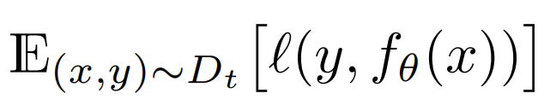
B1a. Decoder Training Stabilization
What Continual Learning methods are there?
Rehearsal-based methods aims to manage the training dataset ER[1]
Pretrain on
Task A
Adapt on
Task B
Untrained Model
Task A Model
Model adapted to Task B
Dataset for
Task A
Dataset for
Task B
+
10%
Training loss during adaptation:
Task B classification loss
Task A classification loss:
+
$$B$$
$$A$$
Data sample
from task B
Ground
truth
Model
Prediction
Data sample
from Task A
Ground
truth
Model
Prediction
[1] Rolnick, David, et al. "Experience replay for continual learning." Advances in Neural Information Processing Systems 32 (2019).

Slide 39
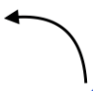
B1a. Decoder Training Stabilization
What Continual Learning methods are there?
Optimization-based methods aims to constrain gradients AGEM [2]
Pretrain on
Task A
Adapt on
Task B
Untrained Model
Task A Model
Model adapted to Task B
Dataset for
Task A
Dataset for
Task B
+
10%
Training loss during adaptation:
Task B classification loss
Task A classification loss:
Gradient Surgery:
g_{B}
proj g_{B}
g_{B}
+
g_{A}
$$B$$
g_{A}
$$A$$
Data sample
from task B
Ground
truth
Model
Prediction
Data sample
from Task A
Ground
truth
Model
Prediction
conflicting
[1] Rolnick, David, et al. "Experience replay for continual learning." Advances in Neural Information Processing Systems 32 (2019).
[2] Chaudhry, Arslan, et al. "Efficient lifelong learning with a-gem." arXiv preprint arXiv:1812.00420 (2018).

Slide 40


B1a. Decoder Training Stabilization
Continual Learning is hard for Transformer decoder
Why?
Gradient surgery performs poorly on the token embeddings
The token embeddings are prone to forgetting
New task knowledge interferes old task knowledge error propagation
Dec Layer 4
EN
i
love
xiao
mi
Dec Layer 3
Enc
Dec Layer 2
T1
T2
Dec Layer 1
T3
T4
…
T100
Token Embed.
Lookup Table

Slide 41
B1a. Decoder Training Stabilization
[1] D. Demeter, G. Kimmel, and D. Downey, “Stolen probability: A structural weakness of neural language models,” arXiv preprint arXiv:2005.02433, 2020.
[2] T. Yu, S. Kumar, A. Gupta, S. Levine, K. Hausman, and C. Finn, “Gradient surgery for multi-task learning,” Advances in Neural Information Processing Systems, vol. 33, pp. 5824–5836, 2020.
Problem: Gradient surgery performs poorly on the token embeddings
Reason:
Token embeddings are sensitive to changes in their norm and angular info [1]
Gradient surgery crudely modify these [2] suboptimal performance
Solution: Remove gradient surgery on the token embeddings
Before
After
Gradient
Surgery
Gradient
Surgery
Dec Layer 4
applied to
Dec Layer 4
applied to
EN
i
love
xiao
mi
Dec Layer 3
Dec Layer 3
Enc
Dec Layer 2
T1
Enc
Dec Layer 2
T1
T2
T2
Dec Layer 1
T3
Dec Layer 1
T3
T4
T4
…
…
T100
T100
Token Embed.
Lookup Table
Token Embed.
Lookup Table

Slide 42
B1a. Decoder Training Stabilization
Problem: The token embeddings are prone to forgetting
Reason:
Different tasks (e.g. languages) may share the same token
To learn new language the shared token may lose the semantic info of old languages
Solution: Freeze the token embeddings not involved with the new task
(A)
(B)
(C)
Shared by
all languages
Kept for old
languages
Duplicate for
new language
Shared by
all languages
Dec Layer 4
T1
T1
T1
T1
T2
T2
T2
T2
EN
i
love
xiao
mi
T3
T3
T3
T3
Dec Layer 3
T4
T4
T4
T4
Enc
Dec Layer 2
T1
frozen
updated
T1: Special token
T2,3,4: Tokens used by old languages
T3,4: Tokens used by new language
T2
T1
Token embedding
Dec Layer 1
T3
T4
…
T100
Token Embed.
Lookup Table

Slide 43
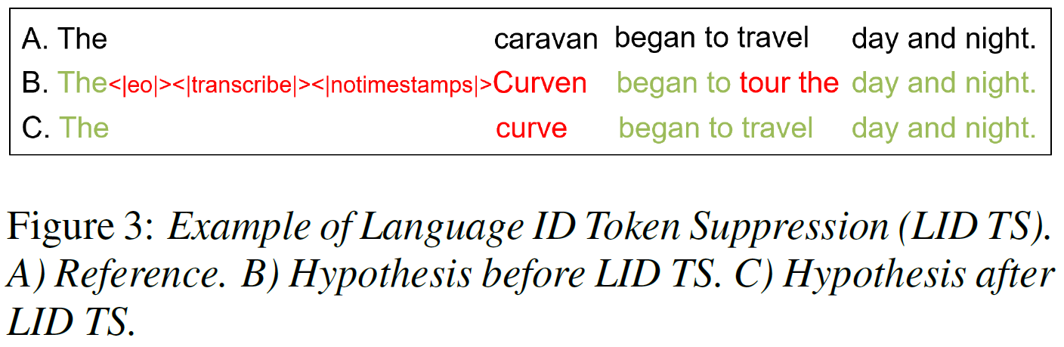
B1a. Decoder Training Stabilization
Problem: New task knowledge interferes old task knowledge error propagation
Reason:
New special tokens are added for new languages
The new tokens interferes with old language tasks
Solution: Suppress the output of new special tokens for old language tasks
Dec Layer 4
EN
i
love
xiao
mi
Dec Layer 3
Enc
Dec Layer 2
T1
T2
Dec Layer 1
T3
T4
…
T100
Token Embed.
Lookup Table

Slide 44

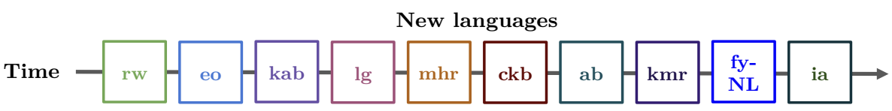
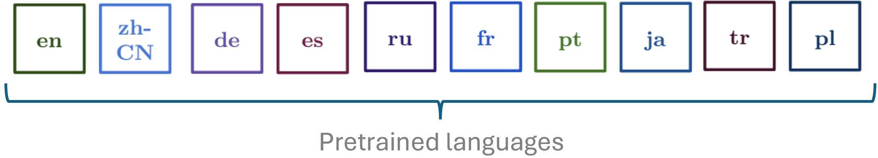
B1a. Decoder Training Stabilization
Experiment Setup
Adapt Whisper [1] to 10 hours of new language dataset from Common Voice [2]
We compare with benchmark [3]
Adapt sequentially: 10 new languages
Test forgetting: 10 pretrained languages (1h for rehearsal)
EN
i
love
xiao
mi
[1] Ardila, Rosana, et al. "Common voice: A massively-multilingual speech corpus." arXiv preprint arXiv:1912.06670 (2019).
[2] Radford, Alec, et al. "Robust speech recognition via large-scale weak supervision." International Conference on Machine Learning. PMLR, 2023.
[3] Della Libera, Luca, et al. "CL-MASR: A Continual Learning Benchmark for Multilingual ASR." arXiv preprint arXiv:2310.16931 (2023).

Slide 45
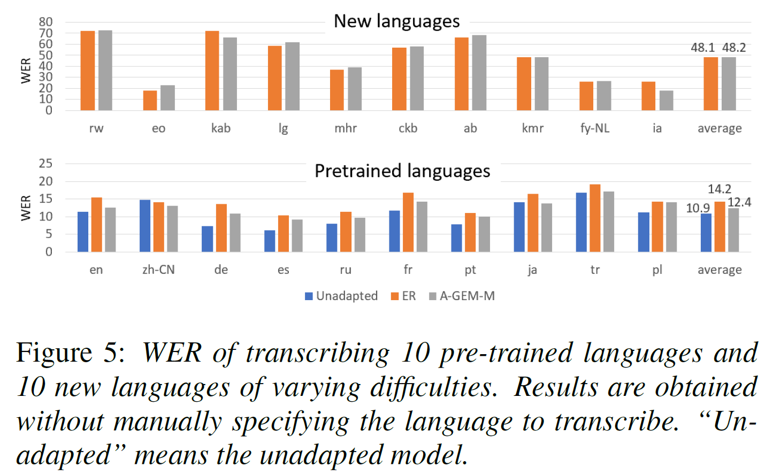
B1a. Decoder Training Stabilization
Results
ER: Rehearsal-based continual learning baseline method
A-GEM-M: Our method with the 3 improvements
EN
i
love
xiao
mi

Slide 46
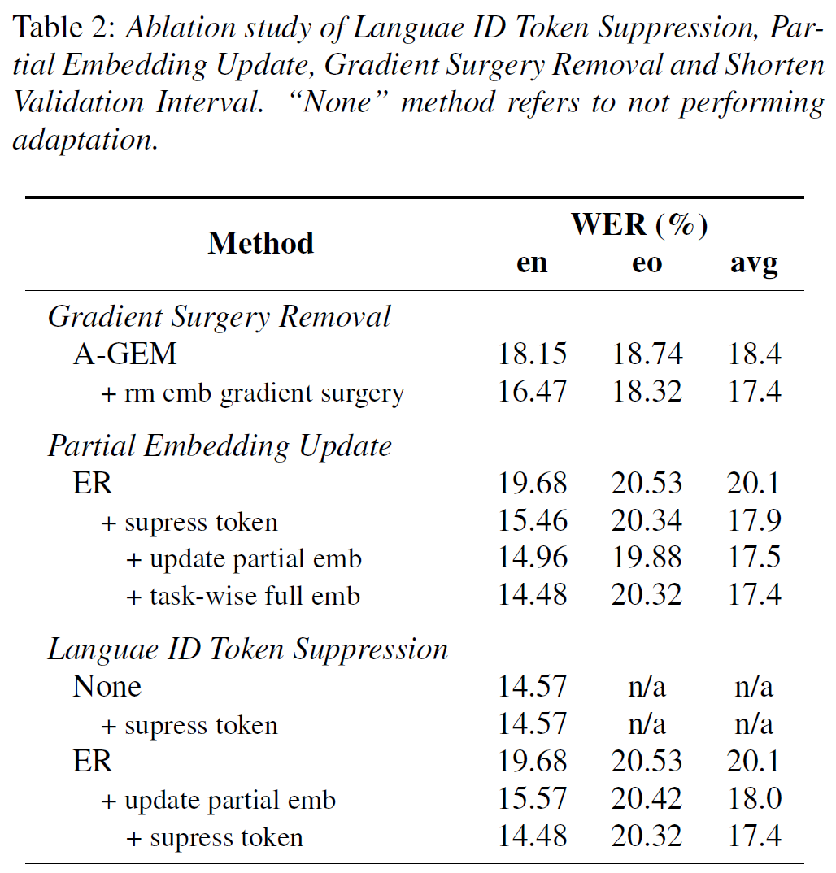
B1a. Decoder Training Stabilization
Ablation Study
All our improvements are effective to reduce forgetting
EN
i
love
xiao
mi

Slide 47
Outline
Introduction
Speech Foundation Model
Low-resource Adaptation
Cross Language Adaptation
Rare Word Adaptation
Contributions
Cross Language Adaptation
Decoder Training Stabilization
Embedding Layer Surgery
Two-stage LoRA
Rare Word Adaptation
TCPGen with Rare-word-aware Loss
Trie-based Postprocessing with K-step Prediction
Conclusions & Future Work

Slide 48
B1b. Embedding Layer Surgery
Previously, we propose to freeze part of the embeddings not involved with the new task
Problem: Only effective when the new task use a small fraction of the available tokens
Extreme case: what if all embeddings are used by the new task?
The only solution is to keep two copies of token embeddings
Case: New task only use token 5
Case: New task use all tokens
(A)
(B)
(C)
(A)
(B)
(C)
Shared by
all languages
Kept for old
languages
Duplicate for
new language
Shared by
all languages
Shared by
all languages
Kept for old
languages
Duplicate for
new language
Shared by
all languages
T1
T1
T1
T1
T1
T1
T1
T1
T2
T2
T2
T2
T2
T2
T2
T2
EN
i
love
xiao
mi
T3
T3
T3
T3
T3
T3
T3
T3
T4
T4
T4
T4
T4
T4
T4
T4
T5
T5
T5
T5
T5
T5
T5
T5
frozen
updated
T1,2: Special token
T3,4,5: Tokens used by old languages
T5: Tokens used by new language
frozen
updated
T1,2: Special token
T3,4,5: Tokens used by old languages
T3,4,5: Tokens used by new language
T1
Token embedding
T1
Token embedding

Slide 49


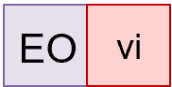
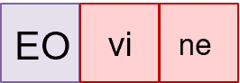
B1b. Embedding Layer Surgery
Problem: Keeping two copies of token embeddings causes LID to fail
EO
vi
(Original)
Steps
EO
vi
ne
devos
Identify input audio
is speaking Esperanto
Select Esperanto
Emb. Lookup Table
EO
vi
(B)
ne
Kept for old
languages
Duplicate for
new language
Output
T1
T1
EO
T2
T2
EN
i
love
xiao
mi
T3
T3
T4
T4
T5
T5
Output :
Output :
Token Embed.
Lookup Table
for
old languages
Token Embed.
Lookup Table
for
new language
Esperanto (EO)

Slide 50
B1b. Embedding Layer Surgery
Problem: Keeping two copies of token embeddings cause LID to fail
Solution: Share the special token embeddings between languages
Kept for old
languages
Duplicate for
new language
Shared between
languages
EO
vi
(Original)
(Our Method)
T3
T3
T4
T4
T1
Steps
Emb. used
Steps
T5
T5
T2
EO
vi
ne
devos
Identify input audio
is speaking Esperanto
LID Output :
EO
Select Esperanto
Emb. Lookup Table
Given that the LID output is “EO” , select Esperanto Emb. Lookup Table
EO
vi
(B)
ne
Kept for old
languages
Duplicate for
new language
Output
T1
T1
EO
T2
T2
EN
i
love
xiao
mi
T3
T3
T4
T4
T5
T5
Output :
Output :
Token Embed.
Lookup Table
for
old languages
Token Embed.
Lookup Table
for
new language
Esperanto (EO)

Slide 51
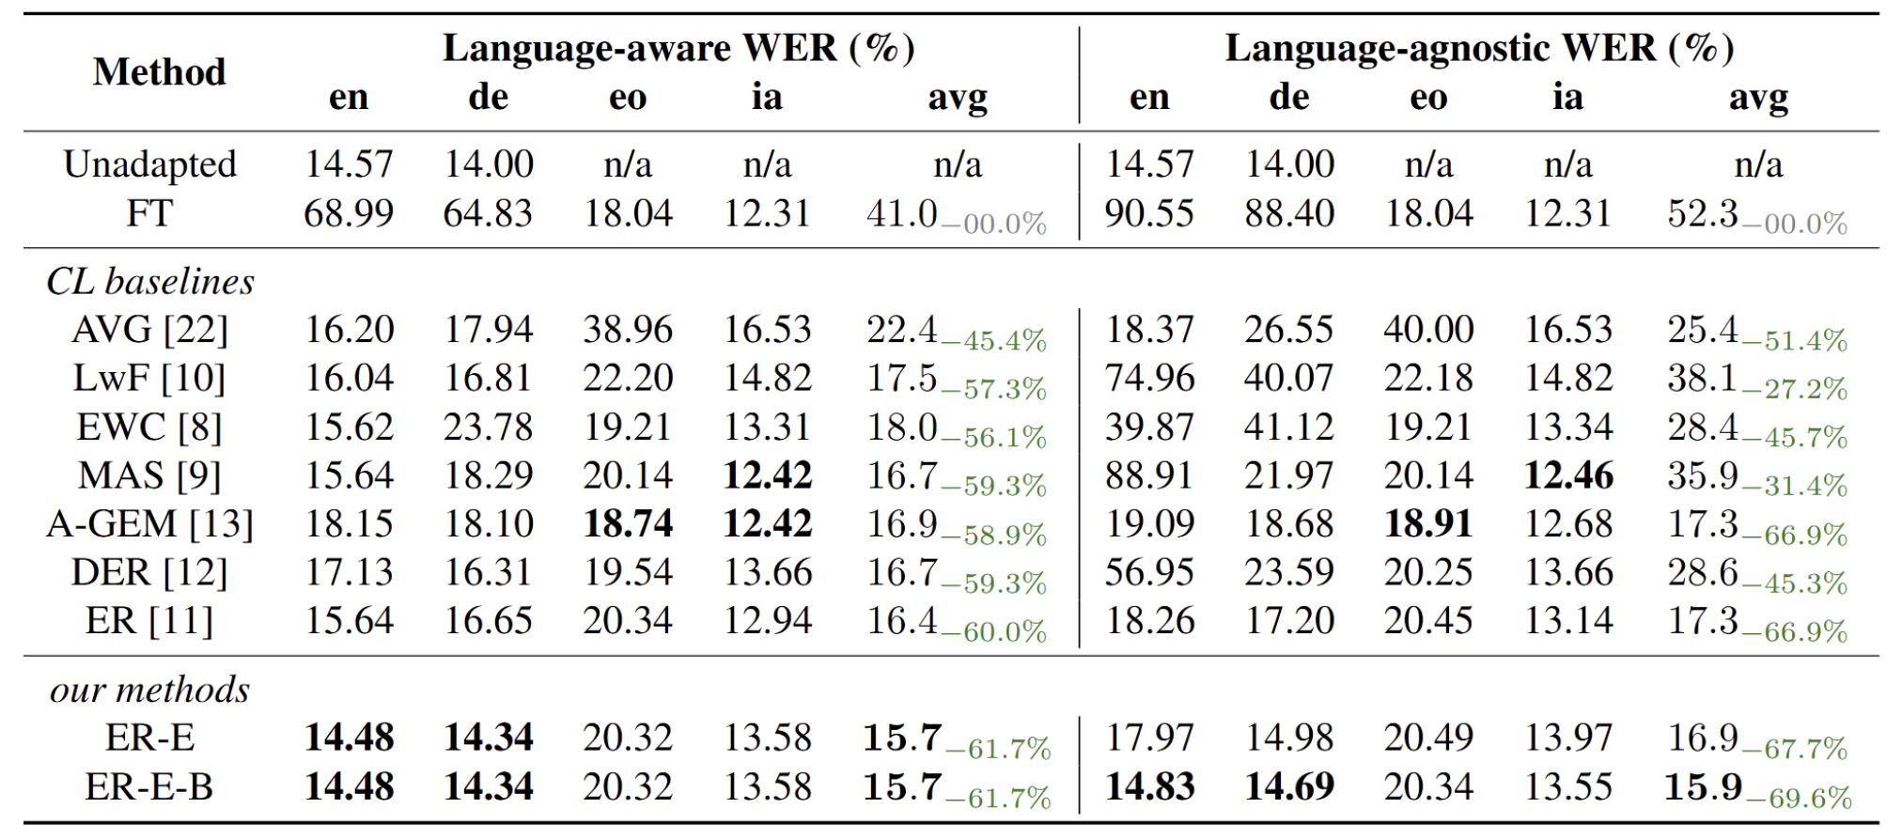
B1b. Embedding Layer Surgery
Experiment Setup: Adapt Whisper to perform ASR in new languages IA and EO
Results
Language-aware means the model is provided with the ground-truth LID result to perform ASR
Language-agnostic means the model needs to perform LID before performing ASR
EN
i
love
xiao
mi

Slide 52
Outline
Introduction
Speech Foundation Model
Low-resource Adaptation
Cross Language Adaptation
Rare Word Adaptation
Contributions
Cross Language Adaptation
Decoder Training Stabilization
Embedding Layer Surgery
Two-stage LoRA
Rare Word Adaptation
TCPGen with Rare-word-aware Loss
Trie-based Postprocessing with K-step Prediction
Conclusions & Future Work

Slide 53
(A)
Embedding Layer Surgery
(B)
Embedding Layer Surgery + 2-stage LoRA
Dec Layer 4
Dec Layer 4
select
Dec Layer 3
Dec Layer 3
select
Shared between
languages
Enc
Dec Layer 2
Enc
Dec Layer 2
select
Dec Layer 1
Dec Layer 1
select
English
Speech
Audio
select
English
Speech
Audio
select
English Token
Embed. Lookup Table
frozen
German Token
Embed. Lookup Table
English LoRA
German LoRA
updated

Slide 54
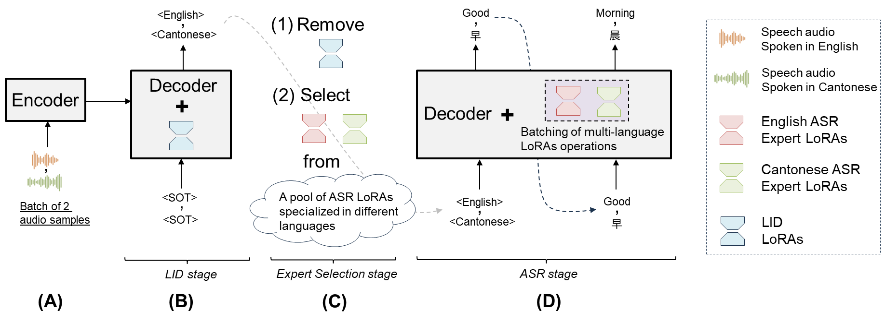
B1c. Two-stage LoRA
Previously, we dynamically switch the embedding lookup table based on LID results
However, the other model parameters are still updated and shared between languages
Solution: Two-stage LoRA to dynamically switch LoRA parameters
EN
i
love
xiao
mi

Slide 55
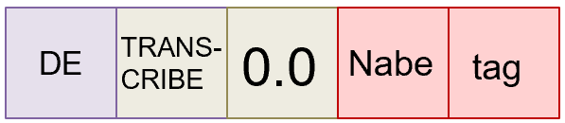


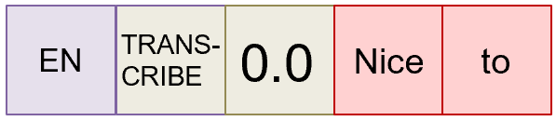
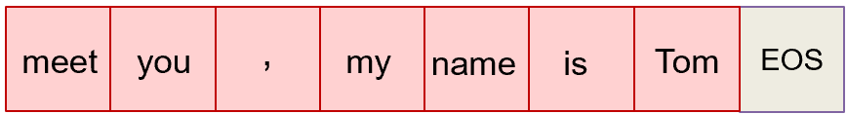
B1c. Two-stage LoRA
Problem of Two-stage LoRA: Incorrect LID results cause ASR errors
Solution: Use language-wise beam search to improve LID performance
Step 1: Decode first few tokens first
Whisper generates tokens sequentially,
starting with a language ID token (purple),
followed by functional tokens (grey),
and then ASR tokens (red).
Audio:
Nice to meet you,
my name is Tom
Decoding Path 1
-1
=
-0.4 +
-0.7
-2.1
+
log probability scores
Speech
Model
Decoding Path 2
Path 1 has
lower score
(A)
-0.3 +
-0.2
=
-0.6
+
-0.1
EN
i
love
xiao
mi
log probability scores
Step 2: Continue to decode the selected path
Decoding Path 1
(B)
The lower score of path 1 suggests that we are decoding in the wrong language
Decoding Path 2 (Cont’d)
(C)
…
Only the decoding of
path 2 continues

Slide 56
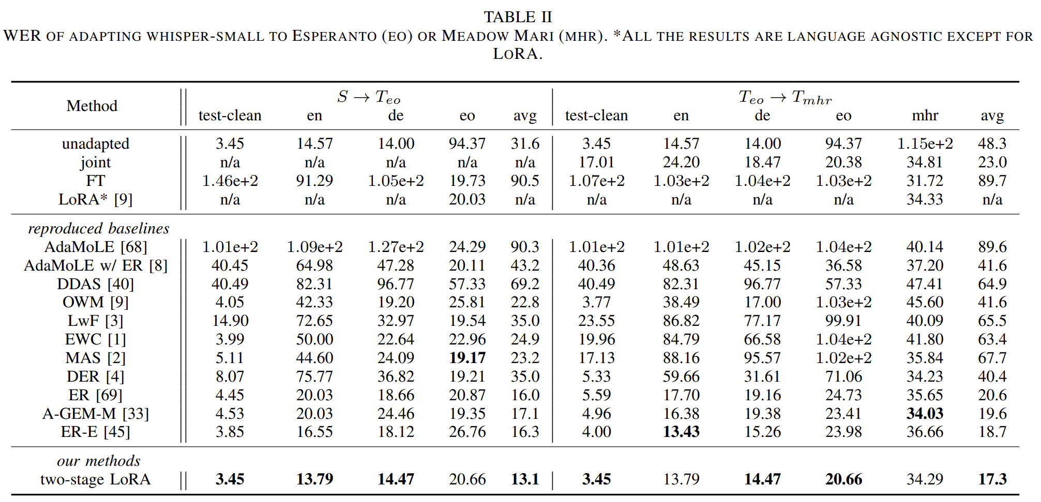
B1c. Two-stage LoRA
Experiment Setup: Adapt Whisper sequentially to new languages EO and then MHR
Results
EN
i
love
xiao
mi

Slide 57
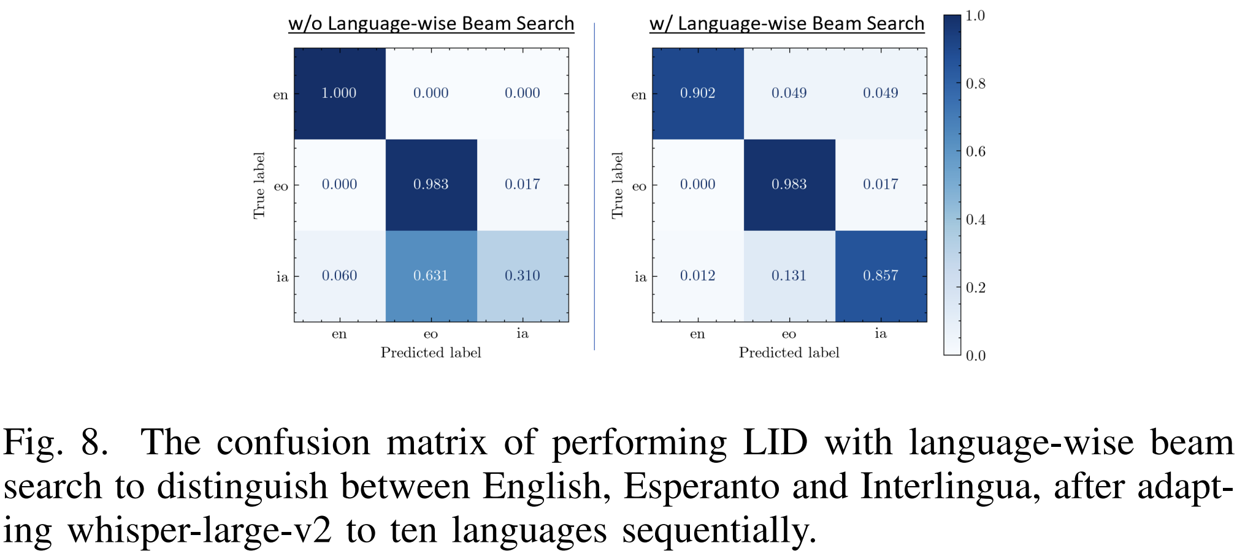
B1c. Two-stage LoRA
Ablation Study
Language-wise beam search improves LID accuracy from 0.31 to 0.857
EN
i
love
xiao
mi

Slide 58
Outline
Introduction
Speech Foundation Model
Low-resource Adaptation
Cross Language Adaptation
Rare Word Adaptation
Contributions
Cross Language Adaptation
Decoder Training Stabilization
Embedding Layer Surgery
Two-stage LoRA
Rare Word Adaptation
TCPGen with Rare-word-aware Loss
Trie-based Postprocessing with K-step Prediction
Conclusions & Future Work

Slide 59
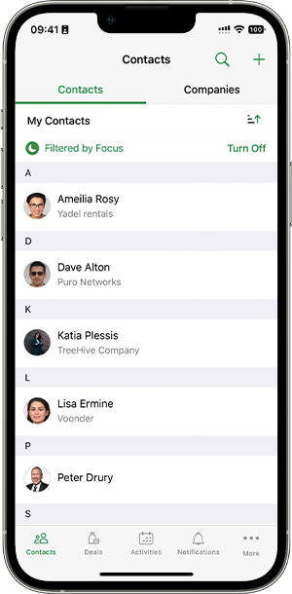
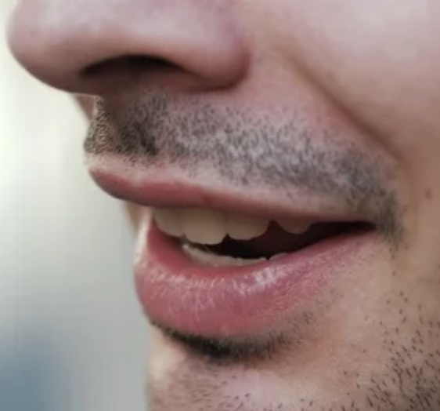
B2. Rare Word Adaptation
What is rare word adaptation?
Bias speech model to output specific rare words
Speech
Model
Call Jury
Drury
Call Drury
Sees the word “Drury” in phone contact
Bias the output to the rare word Drury instead

Slide 60

(A)
(B)
(C)
w/o biasing
w/ biasing network
w/ post-processing
T
Go to bed rock station
T
Go to Bedok station
T
Go to Bedok station
(Non-trainable)
Speech
Decoder
$$⊕$$
Rule-based
Post-process
Speech
Decoder
Biasing
network
Speech
Decoder
Speech
Encoder
(trainable)
Speech
Encoder
Speech
Encoder
Go to Bedok station
Go to Bedok station
Go to Bedok station

Slide 61



B2. Rare Word Adaptation
What are the challenges of rare word adaptation?
Long-tail distribution Rare words rarely occur in training data
Need to effectively adapt models to rare words given limited data
Training data distribution
99.9% common words
Freq.
100 hour
Training data
(only 3 sec
contains
“xiao mi”)
0.01% rare words
Words

Slide 62
Outline
Introduction
Speech Foundation Model
Low-resource Adaptation
Cross Language Adaptation
Rare Word Adaptation
Contributions
Cross Language Adaptation
Decoder Training Stabilization
Embedding Layer Surgery
Two-stage LoRA
Rare Word Adaptation
TCPGen with Rare-word-aware Loss
Trie-based Postprocessing with K-step Prediction
Conclusions & Future Work

Slide 63
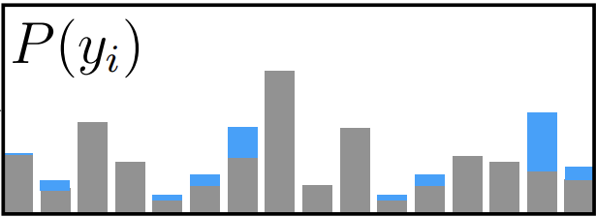
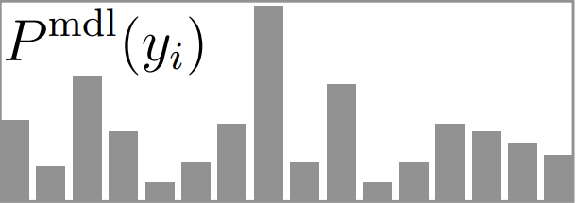










B2a. TCPGen with Rare-word-aware Loss
What methods are there to effectively adapt rare words?
TCPGen [1]: add an extra light-weight decoder to modify the model’s output
Final Output: Next Token Prediction Biased to Token “Kerry”
$$P_{ i}^{gen}$$
$$1−P_{ i}^{gen}$$
=0.8
=0.2
(V)
$$×$$
$$⊕$$
$$×$$
(V)
Interpolation between Whisper and TCP-Gen output
(V)
Token “Gary”
has highest prob
Prob.
Prob.
Token “Kerry”
has highest prob
Length V
Length V
Dec Layer $N_{layer}$
(1)
$$P_{ i}^{gen}$$
$$h_{i−1}^{dec}$$
TCPGen
(V)
$$P_{ }^{ptr}(y_{i})$$
Dec Layer 3
A list of
words
To bias
Previously
decoded
tokens
Weights updated
Weights frozen
Enc
Dec Layer 2
$$y_{1:i−1}$$
V = Vocab. Size
(?) = Tensor Size
Dec Layer 1
Hi Kerry
TEXT
[1] Sun, Guangzhi, Chao Zhang, and Philip C. Woodland. "Tree-constrained pointer generator for end-to-end contextual speech recognition." 2021 IEEE Automatic Speech Recognition and Understanding Workshop (ASRU). IEEE, 2021.

Slide 64









Final Output: Next Token Prediction Biased to Token “Kerry”
$$P_{ i}^{gen}$$
$$1−P_{ i}^{gen}$$
=0.8
=0.2
(V)
$$×$$
$$⊕$$
$$×$$
(V)
Interpolation between Whisper and TCP-Gen output
(V)
(E)
Token “Gary”
has highest prob
Token “Kerry”
has highest prob
(B)
Prob.
Prob.
Length V
Length V
Dec Layer $N_{layer}$
(1)
$$P_{ i}^{gen}$$
(D)
$$h_{i−1}^{dec}$$
TCPGen
(V)
$$P_{ }^{ptr}(y_{i})$$
Dec Layer 3
A list of
words
To bias
Previously
decoded
tokens
Weights updated
Weights frozen
Enc
Dec Layer 2
$$y_{1:i−1}$$
V = Vocab. Size
(?) = Tensor Size
(A)
(C)
Dec Layer 1
Hi Kerry
TEXT
[1] Sun, Guangzhi, Chao Zhang, and Philip C. Woodland. "Tree-constrained pointer generator for end-to-end contextual speech recognition." 2021 IEEE Automatic Speech Recognition and Understanding Workshop (ASRU). IEEE, 2021.

Slide 65















B2a. TCPGen with Rare-word-aware Loss
What is the architecture of the TCPGen module?
TCPGen Module
$${\text{σ}( W}_{1} h_{i−1}^{dec}+{{ W}_{2} h}_{i}^{ptr} )$$
(1,)
$$P_{i}^{gen}$$
(D)
Token
Embeddings
(1,768)
(V,768)
(V,768)
768
$$⨂$$
$${ W}_{v}$$
$$h_{i−1}^{dec}$$
(1,768)
(B)
(1,V)
$$\left|V\right|$$
$$P^{ptr}(y_{i})$$
$${ W}_{k}$$
(V,768)
(A)
(V,768)
Find tokens to
bias w/ Trie
& Mask tokens
not to bias
$$P_{ }^{ptr}(y_{i})$$
(1,V)
$${ W}_{q}$$
$$⨂$$
(C)
(1,768)
(1,V)
$\left|V\right|$ or V = vocabulary size
$$⨂$$
Element-wise addition
A list of words
to bias
Previously decoded
tokens
or
= weights updated/frozen
(?) = Tensor Size
$$y_{1:i−1}$$
Weights updated

Slide 66






B2a. TCPGen with Rare-word-aware Loss
How does the masking function work in TCPGen?
(A)
(B)
Tokens to bias
Bias List:
Turin
Turner
Vignette
Build
Trie Graph
Current
context
Tur
Vocabulary size
Vocabulary size
Find tokens to
bias w/ Trie
& Mask tokens
not to bias
(D)
Prob.
Prob.
Previously decoded tokens
(C)
Trie graph
$$y_{1:i−1}$$
= [SOT] [Tur]

Slide 67

B2a. TCPGen with Rare-word-aware Loss
How does the masking function work in TCPGen?
Vocabulary size
Vocabulary size
Find tokens to
bias w/ Trie
& Mask tokens
not to bias
(D)
Prob.
Prob.
Previously decoded tokens
(C)
$$y_{1:i−1}$$
= [SOT] [Tur]
(A)
Tokens to bias
Bias List:
Turin
Turner
Vignette
Build
Trie Graph
(B)
Trie graph

Slide 68






(A)
Biasing list:
Kerry
Tom
 | My | name | Is | Kerry
 | My | name | Is | Gary
 | Tom | Tom | Tom | Kerry
 | 0.012 | 0.009 | 0.001 | 0.81
 | My | name | Is | Kerry
 |  |  |  | Kerry
 | 0 | 0 | 0 | 1
(B)
Ground-truth:
Whisper output:
(C)
$$P^{ptr}\left(y_{i}\right)$$
decides which token to bias:
(D)
$$P_{ i}^{gen}$$
decides when to bias:
(E)
TCP-Gen’s output
Combined output:
(F)
$ℓ_{ptr}$ :
Our training target for
$$P^{ptr}\left(y_{i}\right)$$
(G)
$ℓ_{gen}$ :
Our training target for
$$P^{gen}$$
(H)

Slide 69



B2a. TCPGen with Rare-word-aware Loss
What is the problem of TCPGen?
Still trains on the ASR objective using the standard cross entropy loss
Redundant training on common words
Biasing list:
Kerry
Tom
 | My | name | Is | Kerry
 | My | name | Is | Gary
 | Tom | Tom | Tom | Kerry
 | 0.012 | 0.009 | 0.001 | 0.81
 | My | name | Is | Kerry
 |  |  |  | Kerry
 | 0 | 0 | 0 | 1
Ground-truth:
Whisper output:
$$P_{ }^{ptr}(y_{i})$$
decides which token to bias:
$$P_{ i}^{gen}$$
decides when to bias:
Combined output:
[1] Sun, Guangzhi, Chao Zhang, and Philip C. Woodland. "Tree-constrained pointer generator for end-to-end contextual speech recognition." 2021 IEEE Automatic Speech Recognition and Understanding Workshop (ASRU). IEEE, 2021.

Slide 70


B2a. TCPGen with Rare-word-aware Loss
We propose a rare-word-aware loss function
The loss explicitly trains the model on two objectives:
What to bias
When to perform biasing
Biasing list:
Kerry
Tom
 | My | name | Is | Kerry
 | My | name | Is | Gary
 | Tom | Tom | Tom | Kerry
 | 0.012 | 0.009 | 0.001 | 0.81
 | My | name | Is | Kerry
 |  |  |  | Kerry
 | 0 | 0 | 0 | 1
Ground-truth:
Whisper output:
$$P_{ }^{ptr}(y_{i})$$
decides which token to bias:
$$P_{ i}^{gen}$$
decides when to bias:
Combined output:
Our training target for
$$P^{ptr}\left(y_{i}\right)$$
Our training target for
$$P^{gen}$$
[1] Sun, Guangzhi, Chao Zhang, and Philip C. Woodland. "Tree-constrained pointer generator for end-to-end contextual speech recognition." 2021 IEEE Automatic Speech Recognition and Understanding Workshop (ASRU). IEEE, 2021.

Slide 71

B2a. TCPGen with Rare-word-aware Loss
Experiment Setup
Adapt Whisper to 10 hours of training data with rare words
Tested on two datasets
Dataset 1: National Speech Corpus Part 2 (NSC-Part2) [1]
They are recordings of people asking for directions
We take 13K unique utterances from the dataset
Bias list: We collect words from the dataset if they are not common words [3]
[1] Koh, Jia Xin, et al. "Building the singapore english national speech corpus." Malay 20.25.0 (2019): 19-3.
[2] Henderson, Matthew, Blaise Thomson, and Jason D. Williams. "The second dialog state tracking challenge." Proceedings of the 15th annual meeting of the special interest group on discourse and dialogue (SIGDIAL). 2014.
[3] https://github.com/first20hours/google-10000-english/blob/master/google-10000-english.txt

Slide 72

B2a. TCPGen with Rare-word-aware Loss
Experiment Setup
Adapt Whisper to 10 hours of training data with rare words
Tested on two datasets
Dataset 2: The second dialog state tracking challenge (DSTC2) [2]
Human-machine task-oriented dialogue dataset
We take 13K unique utterances from the dataset
Bias list: We collect words that are difficult to recognize in the train set
Example sentences
Clown café is a cheap restaurant in the north part of town
Do you have any others like that, maybe in the south part of town?
Galleria is a cheap restaurant in the south.
What is their phone number and address?
[1] Koh, Jia Xin, et al. "Building the singapore english national speech corpus." Malay 20.25.0 (2019): 19-3.
[2] Henderson, Matthew, Blaise Thomson, and Jason D. Williams. "The second dialog state tracking challenge." Proceedings of the 15th annual meeting of the special interest group on discourse and dialogue (SIGDIAL). 2014.
[3] https://github.com/first20hours/google-10000-english/blob/master/google-10000-english.txt

Slide 73

B2a. TCPGen with Rare-word-aware Loss
Results on NSC-Part2

Slide 74

B2a. TCPGen with Rare-word-aware Loss
Results on DSTC2

Slide 75
Outline
Introduction
Speech Foundation Model
Low-resource Adaptation
Cross Language Adaptation
Rare Word Adaptation
Contributions
Cross Language Adaptation
Decoder Training Stabilization
Embedding Layer Surgery
Two-stage LoRA
Rare Word Adaptation
TCPGen with Rare-word-aware Loss
Trie-based Postprocessing with K-step Prediction
Conclusions & Future Work

Slide 76
B2b. Trie-based Postprocessing with K-step Prediction
What is beam search?
Beam Search w/ Beam size 2 = Only keep two partial hypothesis at any time
Decoding step 2
Partial hypothesis 1
Cumulative p=0.6*0.55=0.33
p=0.55
quick
p=0.6
the
quite
Partial hypothesis 2
Cumulative p=0.6*0.55=0.27
SOS
p=0.45
p=0.7
quick
Partial hypothesis 3
Cumulative p=0.4*0.7=0.28
p=0.4
a
p=0.3
quiet
Partial hypothesis 4
Cumulative p=0.4*0.3=0.12
Decoding step 3
p=0.7
brown
Partial hypothesis 1
Cumulative p=0.231
p=0.55
quick
fox
Partial hypothesis 2
Cumulative p=0.099
p=0.6
the
quite
p=0.3
SOS
p=0.45
p=0.7
quick
p=0.4
p=0.4
a
Partial hypothesis 3
Cumulative p=0.112
quiet
p=0.3
quiet
p=0.6
brown
Partial hypothesis 4
Cumulative p=0.168
[1] Sun, Guangzhi, Chao Zhang, and Philip C. Woodland. "Tree-constrained pointer generator for end-to-end contextual speech recognition." 2021 IEEE Automatic Speech Recognition and Understanding Workshop (ASRU). IEEE, 2021.

Slide 77
B2b. Trie-based Postprocessing with K-step Prediction
What is beam search?
Beam Search w/ Beam size 2 = Only keep two partial hypothesis at any time
Decoding step 2
p=0.55
quick
Partial hypothesis 1
score=log(0.6)+log(0.55)=-0.48
p=0.6
the
quite
Partial hypothesis 2
score=log(0.6)+log(0.45)=-0.57
SOS
p=0.45
p=0.7
quick
Partial hypothesis 3
score=log(0.4)*log(0.7)=-0.55
p=0.4
a
p=0.3
quiet
Partial hypothesis 4
score=log(0.4)+log(0.3)=-0.92
[1] Sun, Guangzhi, Chao Zhang, and Philip C. Woodland. "Tree-constrained pointer generator for end-to-end contextual speech recognition." 2021 IEEE Automatic Speech Recognition and Understanding Workshop (ASRU). IEEE, 2021.

Slide 78
B2b. Trie-based Postprocessing with K-step Prediction
What is beam search?
Beam Search w/ Beam size 2 = Only keep two partial hypothesis at any time
Decoding step 3
p=0.7
brown
Partial hypothesis 1
score=-0.63
p=0.55
quick
fox
Partial hypothesis 2
score=-1.00
p=0.6
the
quite
p=0.3
SOS
p=0.45
p=0.7
quick
p=0.4
p=0.4
a
Partial hypothesis 3
score=-0.95
quiet
p=0.3
quiet
p=0.6
brown
Partial hypothesis 4
score=-0.77
[1] Sun, Guangzhi, Chao Zhang, and Philip C. Woodland. "Tree-constrained pointer generator for end-to-end contextual speech recognition." 2021 IEEE Automatic Speech Recognition and Understanding Workshop (ASRU). IEEE, 2021.

Slide 79
B2b. Trie-based Postprocessing with K-step Prediction
What is trie-based postprocessing?
Read a bias list, reward output that extends to the words in the bias list
Beam Search w/ Beam size 2 = Only keep two partial hypothesis at any time
Decoding step 2
p=0.55
quick
Partial hypothesis 1
score=log(0.6)+log(0.55)=-0.48
p=0.6
the
quite
Partial hypothesis 2
score=log(0.6)+log(0.45)=-0.57
SOS
p=0.45
p=0.7
quick
Partial hypothesis 3
score=log(0.4)*log(0.7)=-0.55
p=0.4
a
p=0.3
quiet
Partial hypothesis 4
score=log(0.4)+log(0.3)=-0.92
Bias list:
Quiet cat
Cute dog
Happy hippo
[1] Sun, Guangzhi, Chao Zhang, and Philip C. Woodland. "Tree-constrained pointer generator for end-to-end contextual speech recognition." 2021 IEEE Automatic Speech Recognition and Understanding Workshop (ASRU). IEEE, 2021.

Slide 80


B2b. Trie-based Postprocessing with K-step Prediction
What is trie-based postprocessing?
Read a bias list, reward output that extends to the words in the bias list
Beam Search w/ Beam size 2 = Only keep two partial hypothesis at any time
Decoding step 2
p=0.55
quick
Partial hypothesis 1
score=log(0.6)+log(0.55)=-0.48
p=0.6
the
quite
Partial hypothesis 2
score=log(0.6)+log(0.45)=-0.57
SOS
p=0.45
p=0.7
quick
Partial hypothesis 3
score=log(0.4)*log(0.7)=-0.55
p=0.4
a
p=0.3
quiet
Partial hypothesis 4
score=log(0.4)+log(0.3)+$α$=-0.92+10=9.08
Bias list:
Quiet cat
Cute dog
Happy hippo
Add reward $α=10$
[1] Sun, Guangzhi, Chao Zhang, and Philip C. Woodland. "Tree-constrained pointer generator for end-to-end contextual speech recognition." 2021 IEEE Automatic Speech Recognition and Understanding Workshop (ASRU). IEEE, 2021.

Slide 81

B2b. Trie-based Postprocessing with K-step Prediction
What is trie-based postprocessing?
Read a bias list, reward output that extends to the words in the bias list
If the output does not extend to the complete biased phrase, revoke reward
Beam Search w/ Beam size 2 = Only keep two partial hypothesis at any time
Decoding step 3
p=0.7
brown
Partial hypothesis 1
score=-0.63
p=0.55
quick
fox
Partial hypothesis 2
score=-1.00
p=0.6
the
quite
p=0.3
SOS
p=0.45
p=0.7
quick
p=0.4
a
p=0.4
Partial hypothesis 3
score=-0.95
quiet
p=0.3
quiet
brown
Partial hypothesis 4
score=8.86 - $α$=-0.77
p=0.6
Bias list:
Quiet cat
Cute dog
Happy hippo
Does not extend to quiet cat. Revoke reward
[1] Sun, Guangzhi, Chao Zhang, and Philip C. Woodland. "Tree-constrained pointer generator for end-to-end contextual speech recognition." 2021 IEEE Automatic Speech Recognition and Understanding Workshop (ASRU). IEEE, 2021.

Slide 82

B2b. Trie-based Postprocessing with K-step Prediction
How to improve Trie-based postprocessing with K-step prediction?
[1] Sun, Guangzhi, Chao Zhang, and Philip C. Woodland. "Tree-constrained pointer generator for end-to-end contextual speech recognition." 2021 IEEE Automatic Speech Recognition and Understanding Workshop (ASRU). IEEE, 2021.

Slide 83

B2b. Trie-based Postprocessing with K-step Prediction
How to extend models with K-step prediction capabilities?
[1] Sun, Guangzhi, Chao Zhang, and Philip C. Woodland. "Tree-constrained pointer generator for end-to-end contextual speech recognition." 2021 IEEE Automatic Speech Recognition and Understanding Workshop (ASRU). IEEE, 2021.

Slide 84
B2b. Trie-based Postprocessing with K-step Prediction
Experiment Setup
Adapt Whisper to 10 hours of training data with rare words
Tested on two datasets
Dataset 1: National Speech Corpus Part 2 (NSC-Part2) [1]
They are recordings of people asking for directions
We take 13K unique utterances from the dataset
Bias list: We collect words from the dataset if they are not common words [3]
[1] Sun, Guangzhi, Chao Zhang, and Philip C. Woodland. "Tree-constrained pointer generator for end-to-end contextual speech recognition." 2021 IEEE Automatic Speech Recognition and Understanding Workshop (ASRU). IEEE, 2021.

Slide 85

B2b. Trie-based Postprocessing with K-step Prediction
Results
[1] Sun, Guangzhi, Chao Zhang, and Philip C. Woodland. "Tree-constrained pointer generator for end-to-end contextual speech recognition." 2021 IEEE Automatic Speech Recognition and Understanding Workshop (ASRU). IEEE, 2021.

Slide 86


B2b. Trie-based Postprocessing with K-step Prediction
Ablation Study
[1] Sun, Guangzhi, Chao Zhang, and Philip C. Woodland. "Tree-constrained pointer generator for end-to-end contextual speech recognition." 2021 IEEE Automatic Speech Recognition and Understanding Workshop (ASRU). IEEE, 2021.

